Slide 1
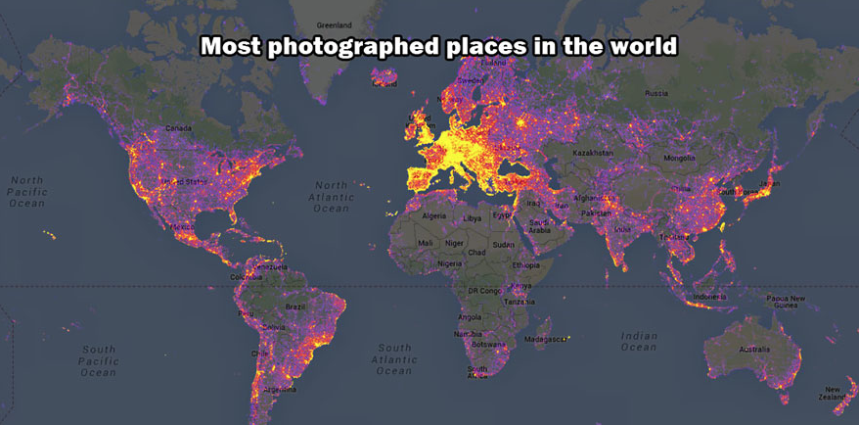
Notes:
https://www.boredpanda.com/interesting-maps/

Slide 2
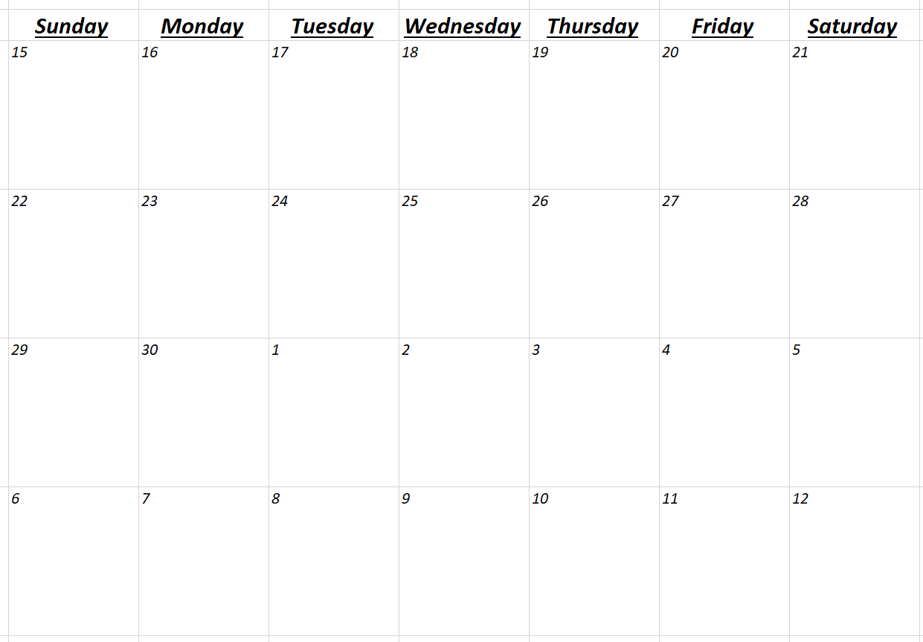
Spatial Statistics
Review
Presentations
Presentations
Presentations
Presentations
Final:
10:30 - 1

Slide 3
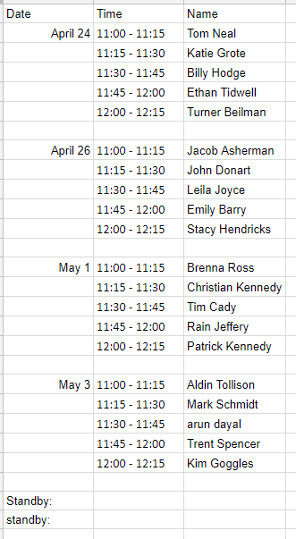
https://docs.google.com/spreadsheets/d/1KgH8wOXCVv5cxIO-AmPd8OyKV8zO6Sf1-IVOidX1uO8/edit?usp=sharing

Slide 4
Final Project Presentation
25% of final grade
Project contents (12)
Problem statements (2)
Methods / analysis (4)
Results (4)
Conclusions (2)
Presentation (11)
Text (3)
Diagrams / figures (4)
Verbal communication (4)
Timing (1)
Participation (1)
~12 minutes w/ time for questions
You will be cut off at 15 minutes
You must ask questions
The following sections should be present
Introduction / Review
Methods
Results
Conclusions and broader impacts

Slide 5
Papers (65% of the final grade)
Introduction
Define the problem in context. Describe why spatial analysis is needed to solve your problem. Review in literature what methods and spatial analysis have been used solving similar problems. Be sure to include a statement like "The objective of this project is to ...".
Methods
Describe the strategy you solve the problem using GIS and any other necessary methods. Describe the statistic method, computer model, GIS analytic functions / operations you use in the problem solving process. Diagrams are especial helpful to understand your strategy.
Study Area and Analysis
Describe the study area. What kind of GIS data and data models are used in the analysis. Present the results of your analysis.
Results & Conclusions
Discuss the findings from your problem solving process. Evaluate your methodology. Discuss the usefulness and limitation of the analytic functions in GIS. Discuss the broader impacts of your findings.
References

Slide 6

Notes:
https://collections.storymaps.esri.com/top-stories-2016/

Slide 7
Presentations
Presentations
Presentations
Presentations
Stop Day
Practical
All labs in
Final:
10:30 - 1
Term Papers due
Practical open

Slide 8
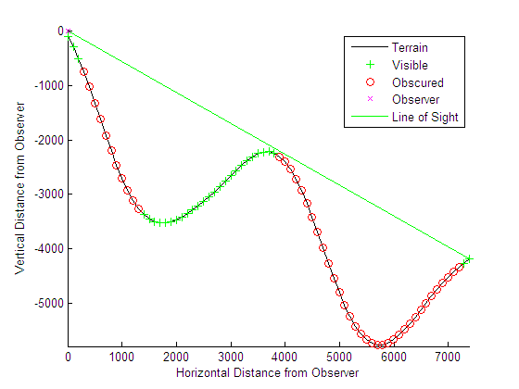
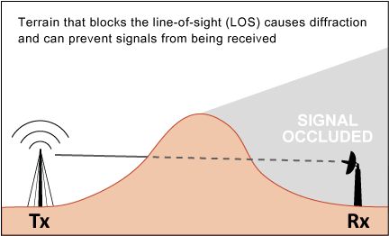
Line of sight
A straight line connects the observation point and the target point without interrupted by terrain at any location in between.
If a line-of-sight exits, the target point is visible from the observation point.

Slide 9
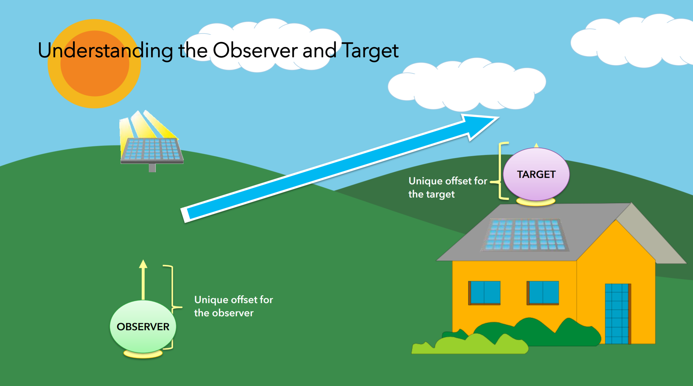
Notes:
http://proceedings.esri.com/library/userconf/proc17/tech-workshops/tw_402-493.pdf

Slide 10
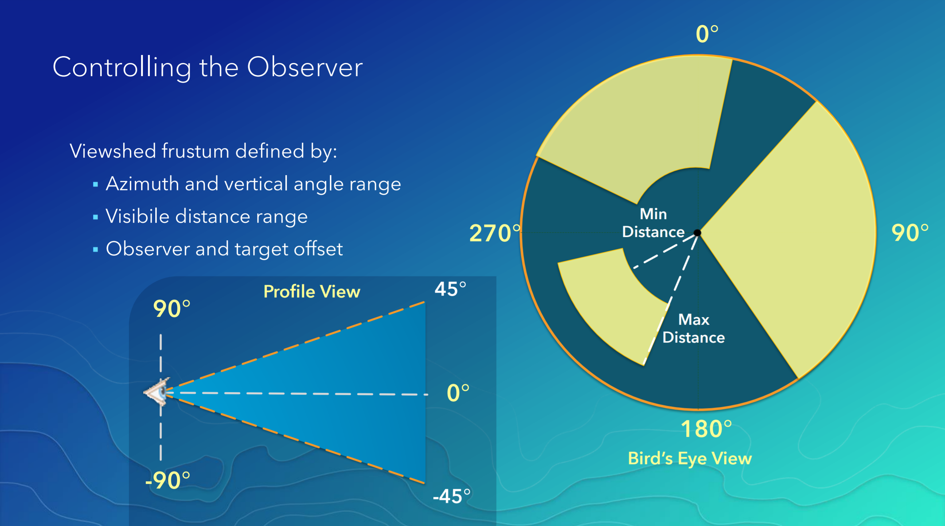
Visibility Analysis Parameters

Slide 11
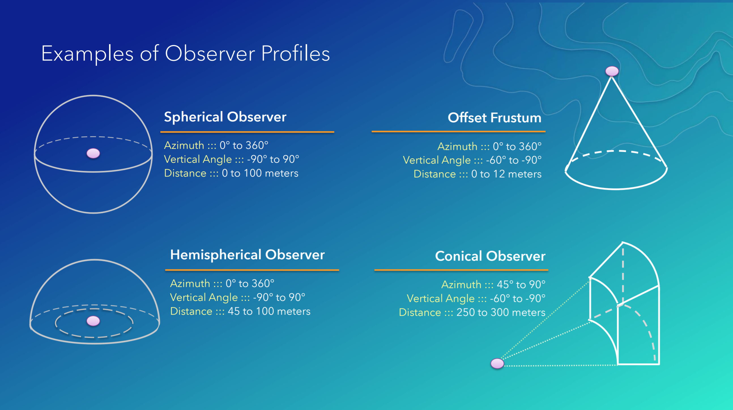

Slide 12
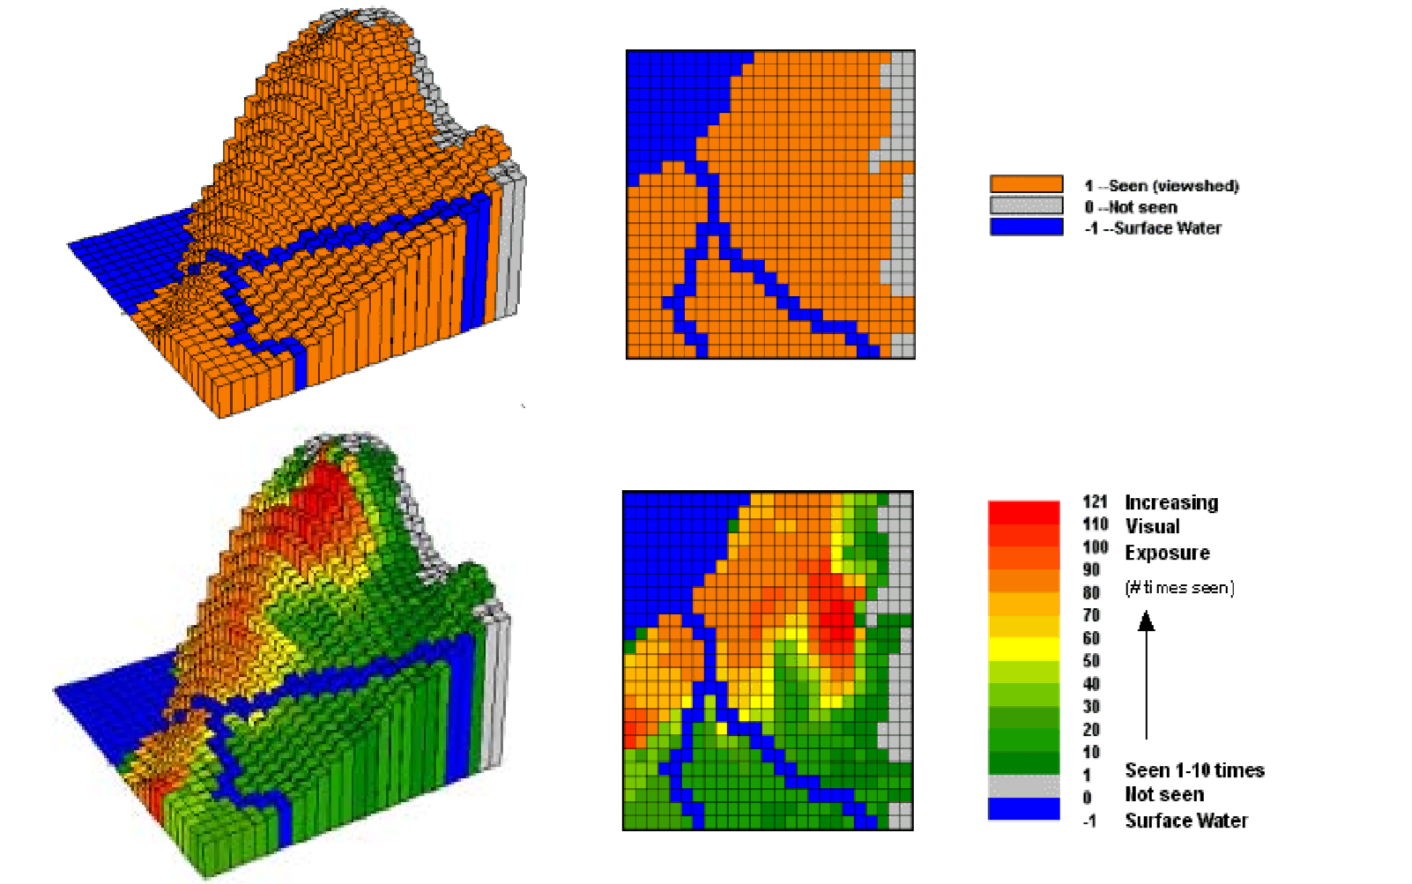
Water Body Visual Exposure Analysis

Slide 13
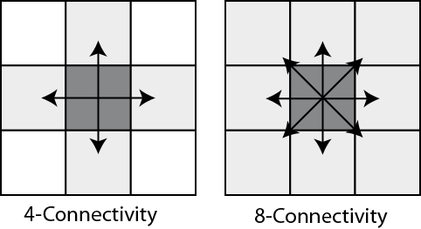
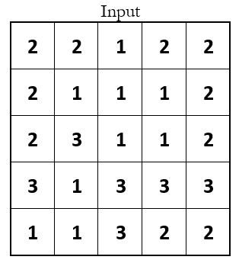
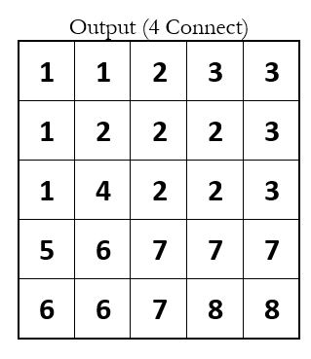
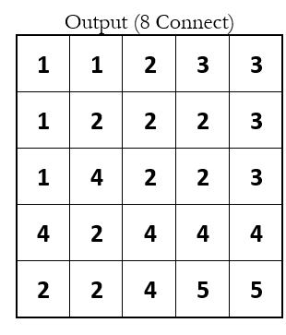

Slide 14
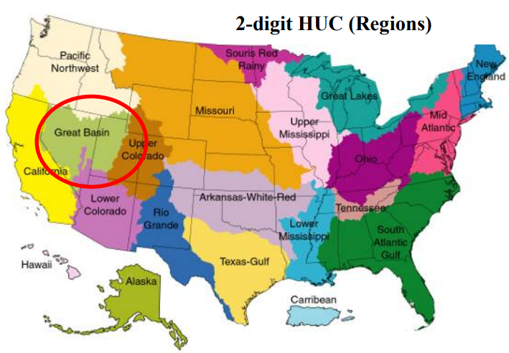
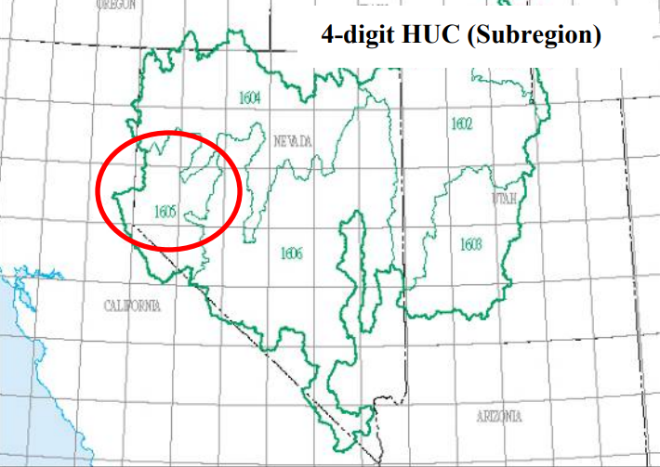
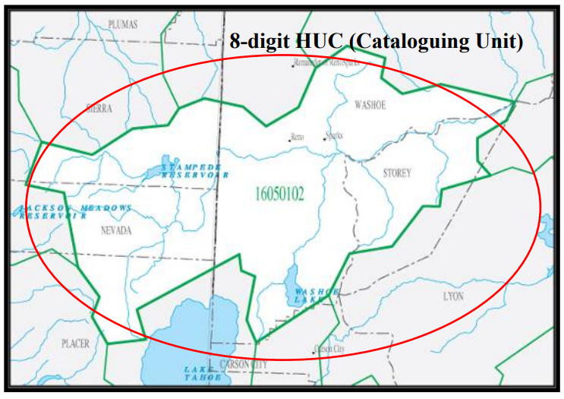
HUC Units
Unique ID for CONUS et al. watersheds
2-digit HUC first-level (region)
4-digit HUC second-level (subregion)
6-digit HUC third-level (accounting unit)
8-digit HUC fourth-level (cataloguing unit)
10-digit HUC fifth-level (watershed)
12-digit HUC sixth-level (subwatershed)

Slide 15
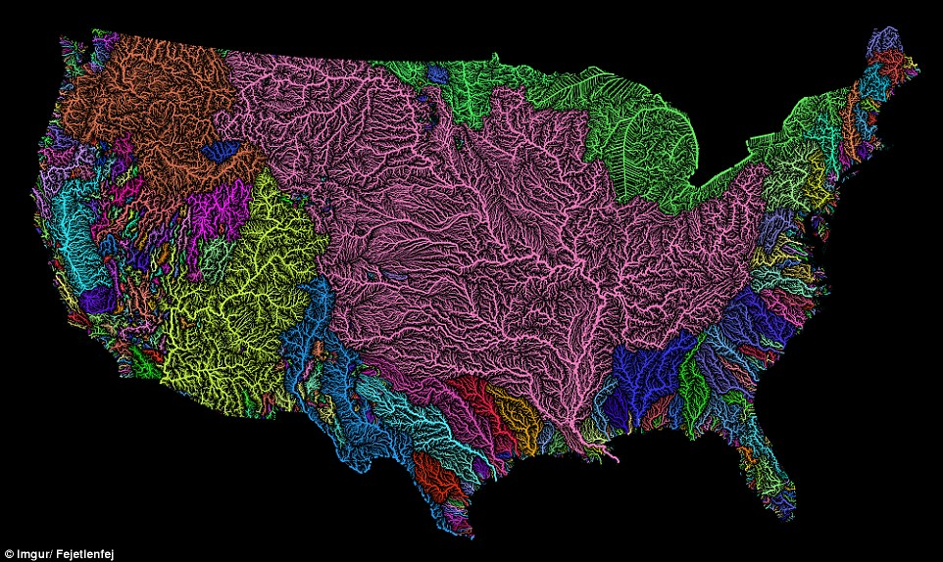
Basin
The drainage basins are delineated within the analysis window by identifying ridge lines between basins.

Slide 16
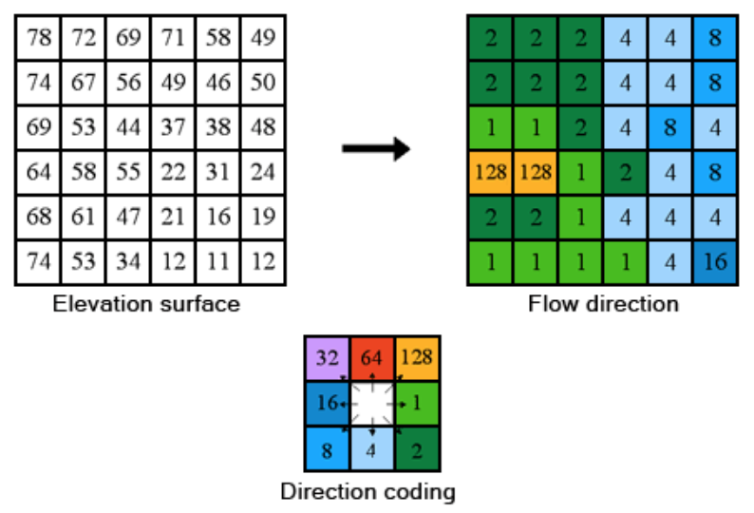
Flow direction
.

Slide 17
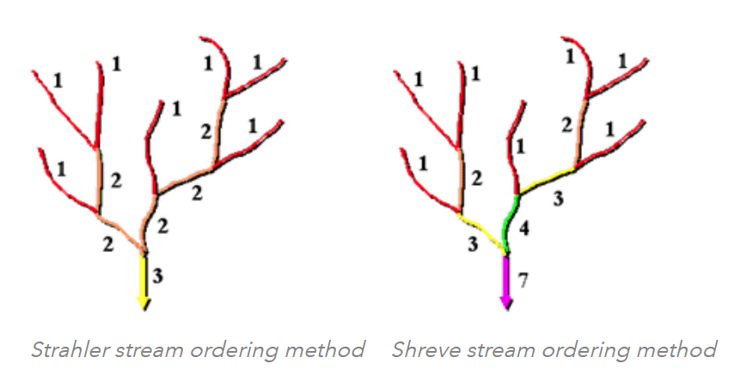
Stream order
.

Slide 18
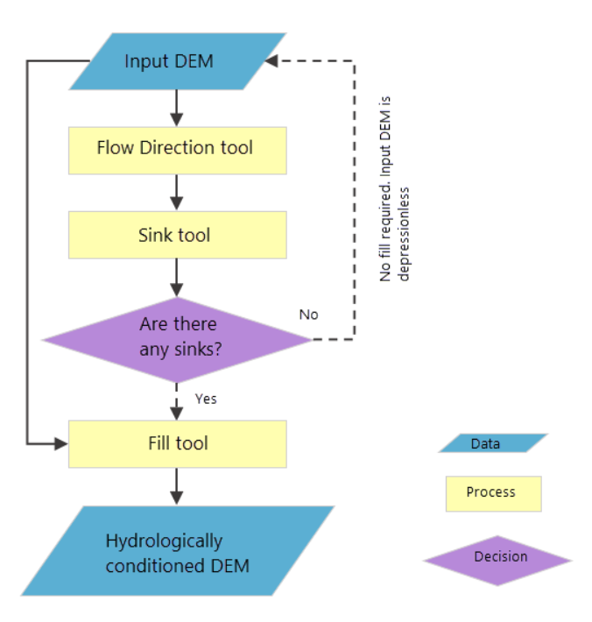
.

Slide 19
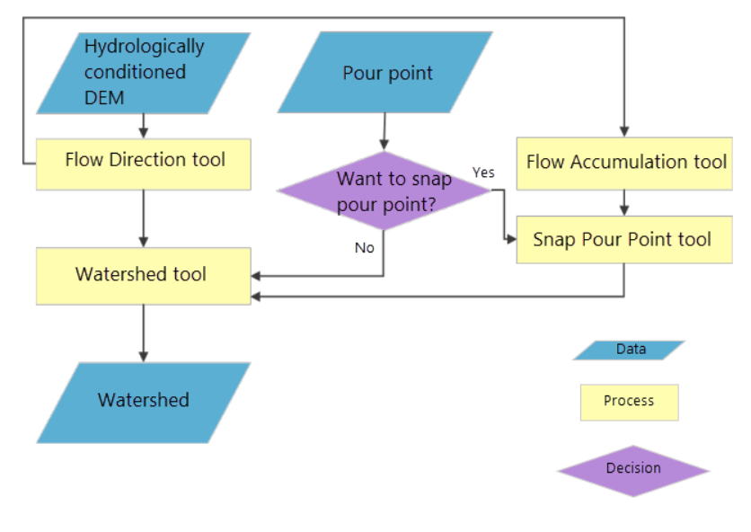
.

Slide 20
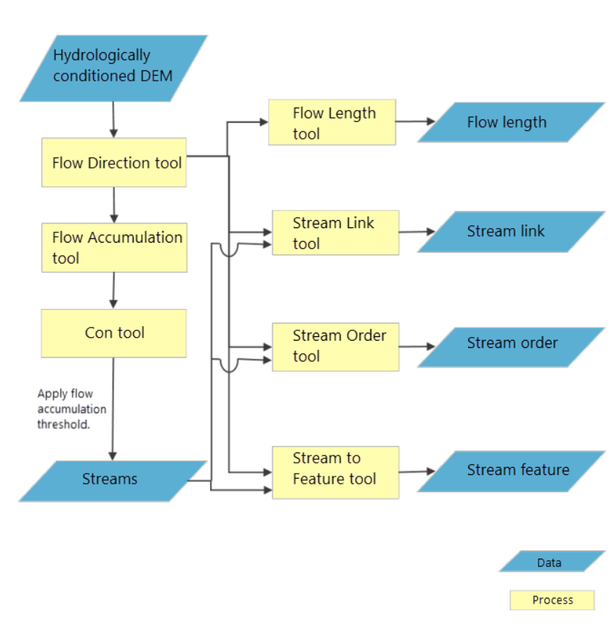
.
Notes:
Akpoti, K.; Antwi, E.O.; Kabo-bah, A.T. Impacts of Rainfall Variability, Land Use and Land Cover Change on Stream Flow of the Black Volta Basin, West Africa. Hydrology 2016, 3, 26.

Slide 21
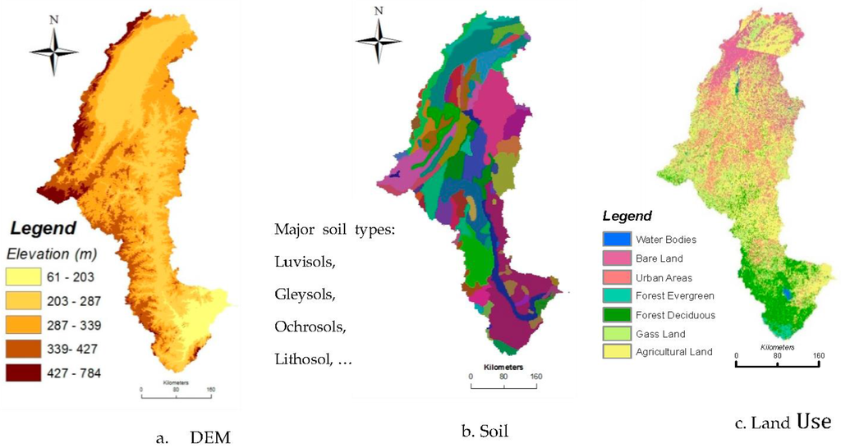
.

Slide 22
Robustness and Resistance
Robustness and resistance are two aspects of insensitivity to assumptions about the nature of a set of data.
Robust methods are not sensitive to particular assumptions about the overall nature of the data. A robust method is not necessarily optimal in any particular circumstance, but performs reasonably well in most circumstances.
Resistant methods are not unduly influenced by a small number of outliers, or error data values.

Slide 23
ArcGIS Interpolation methods
Deterministic
IDW (Inverse Distance Weighted)
Natural neighbor
Trend
Spline
Spline with Barriers
Geostatistical
Kriging
Methodological
Topo to Raster

Slide 24
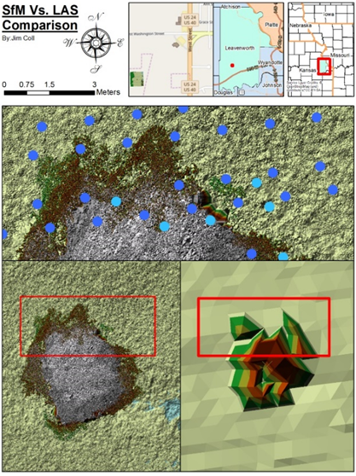
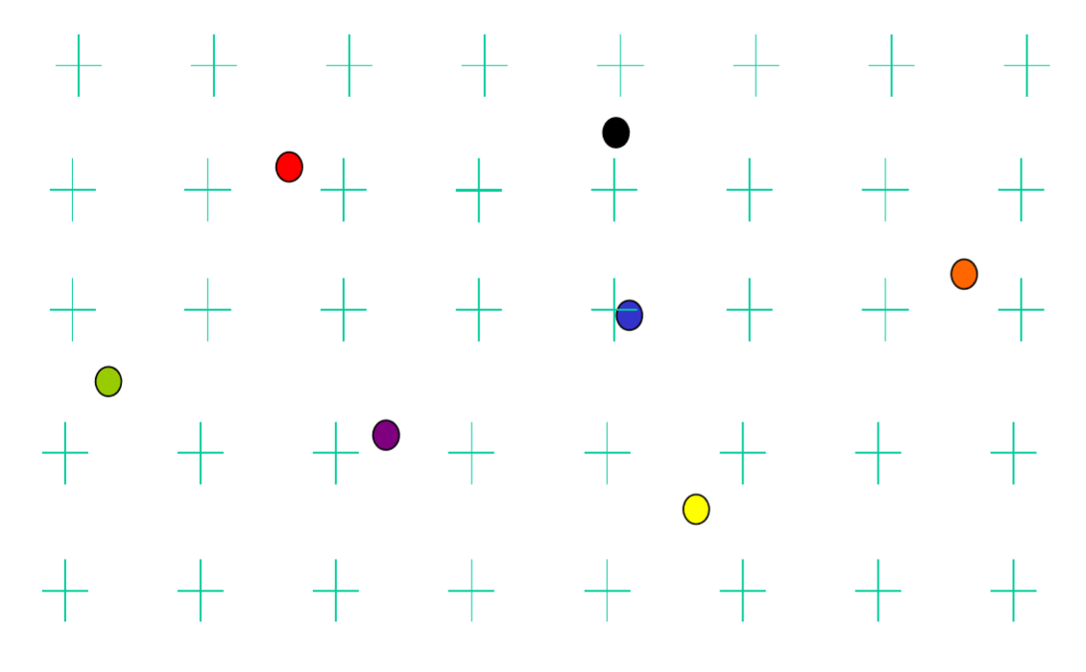

Slide 25
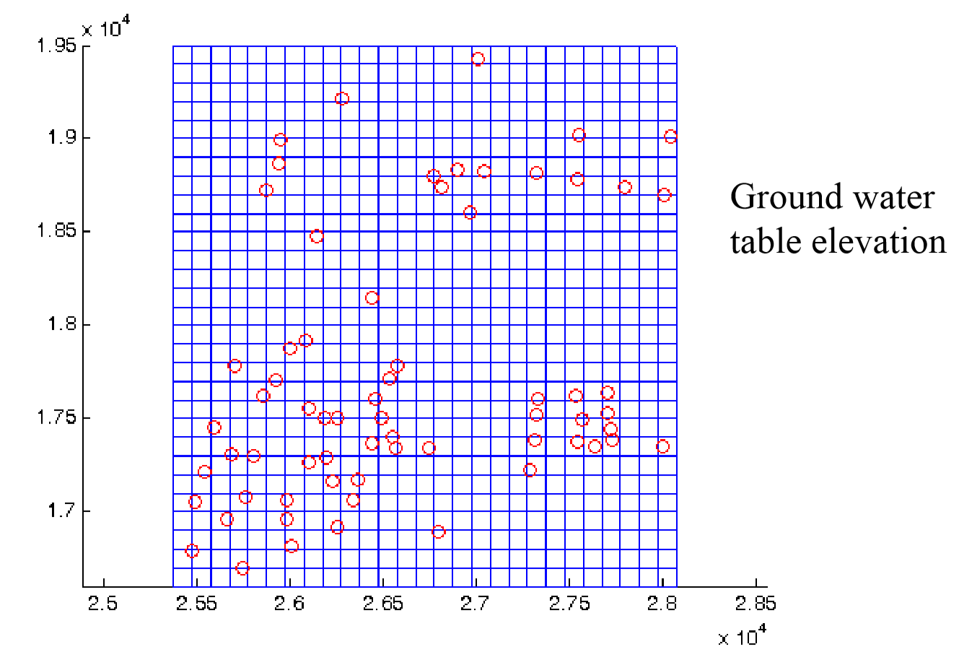

Slide 26
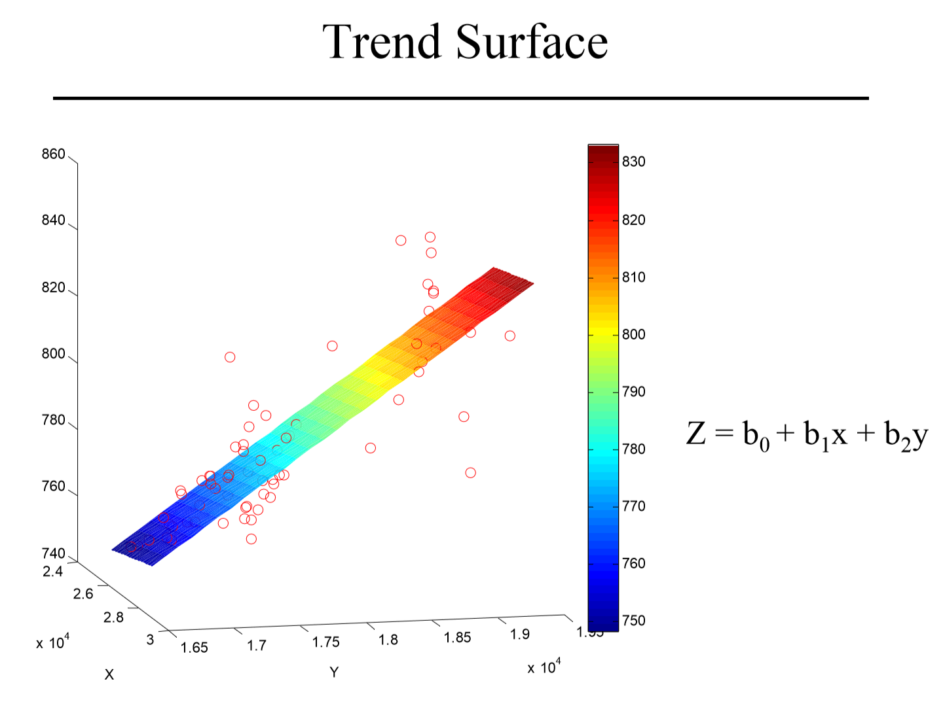

Slide 27
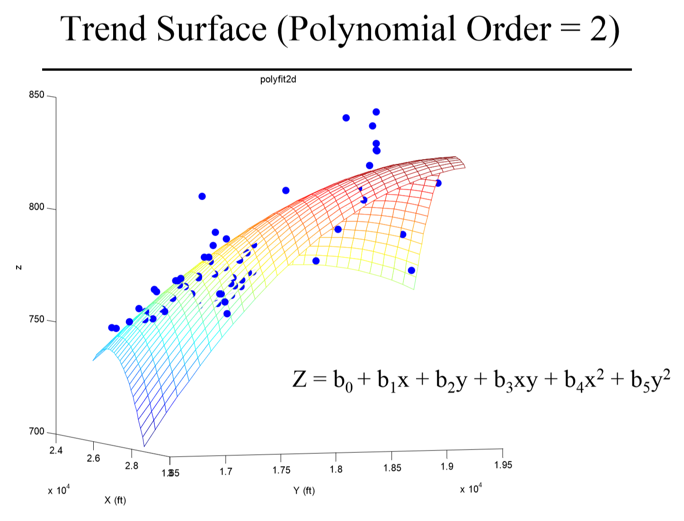

Slide 28
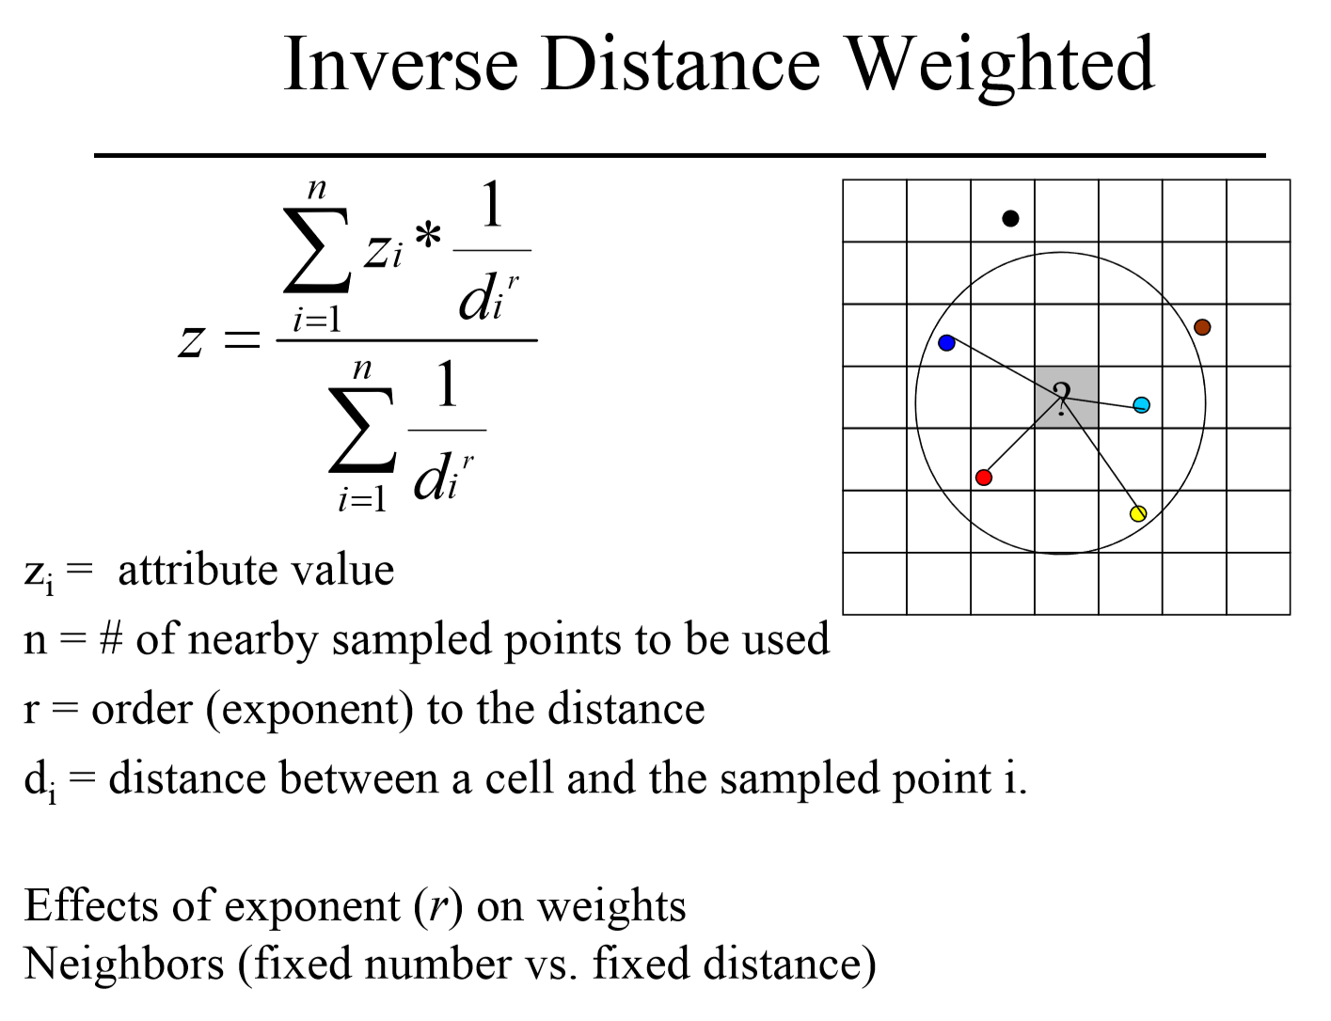
Notes:
https://www.youtube.com/watch?v=5oScAPFAVi0

Slide 29
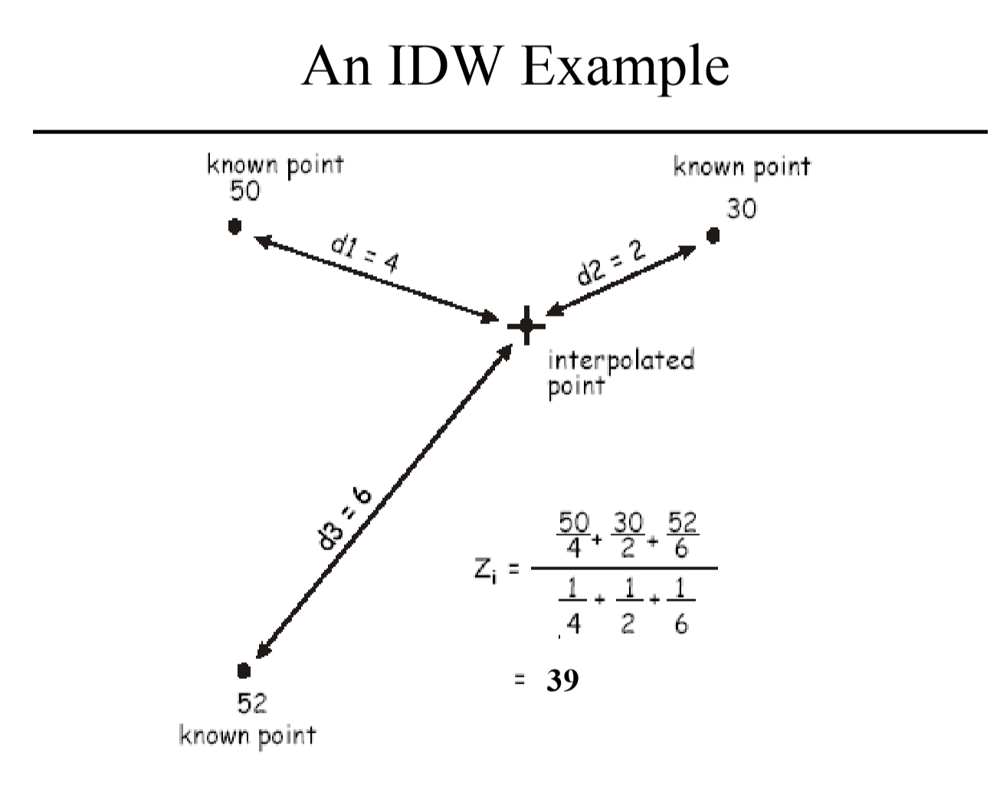

Slide 31
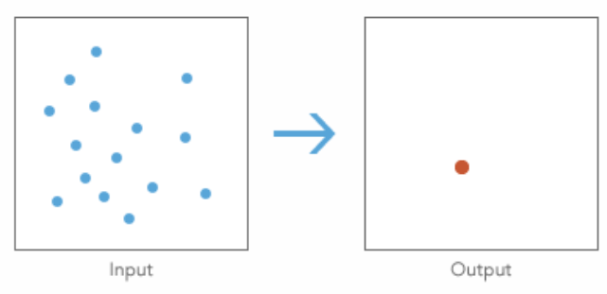
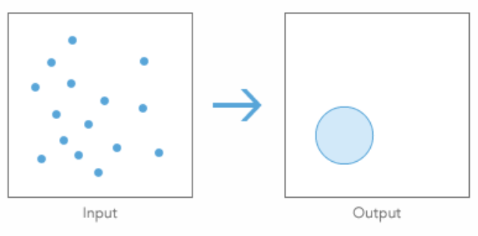
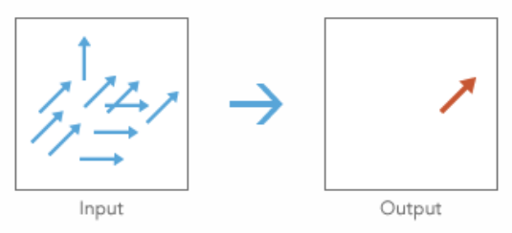
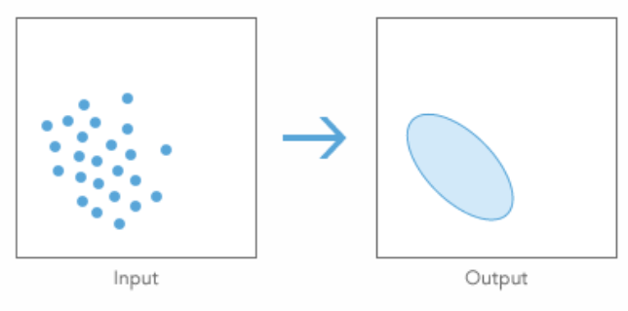
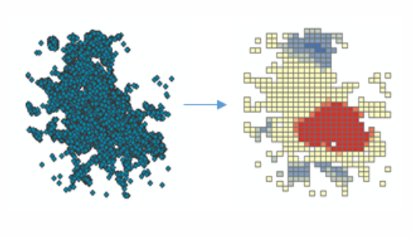
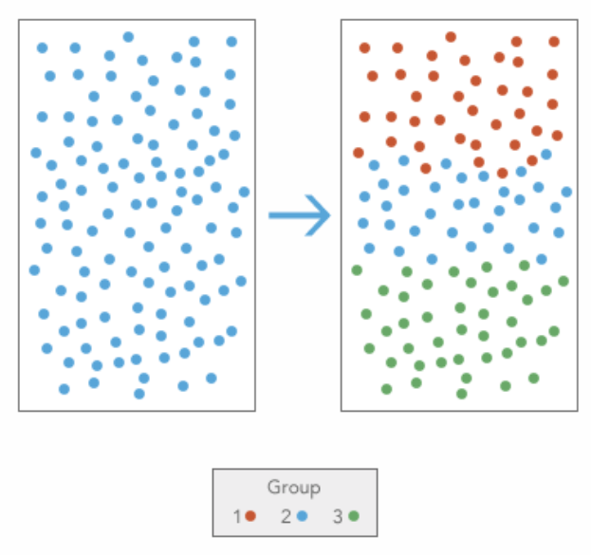
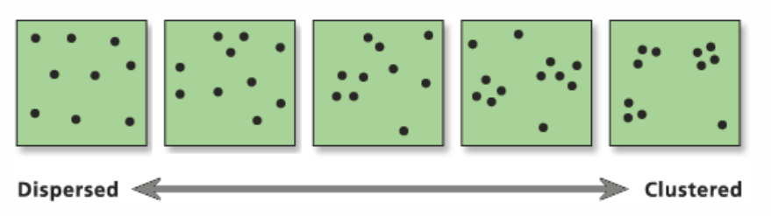
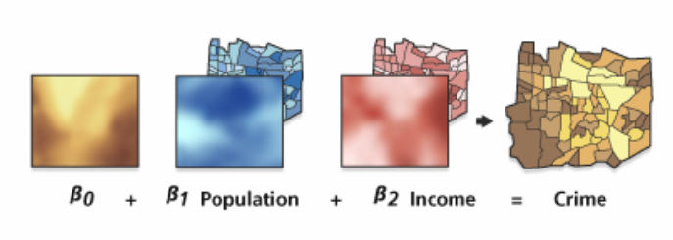
Tool: Central Feature
Tool: Linear Directional Mean
Tool: Standard Distance
Tool: Directional Distribution
Tool: Optimized Hot Spot Analysis
Tool: Grouping Analysis
Tool: Similarity Search
Tool: Average Nearest Neighbor
Tool: Geographically Weighted Regression (GWR)

